Slide 1
Joint reference architecture (JRA) introduced to address questions coming from customers and partners on architectural choices for solving business needs. Solution recommendations based on: foundation, data, integration and application development capabilities Guiding principles by capability for customer and partner decision making Customers benefit from faster time-to-value and lower total-cost-of-ownership
SAP BTP and AWS –
Joint Reference Architectures
Notes:
With a plethora of AWS services , solutions and SAP BTP services, customers are often in need of guiding principles on assembling these services to gain meaningful business outcomes. AWS and SAP have partnered to provide solution recommendations and guiding principles for use cases including and not limited to – connectivity, Full stack application development, Internet of things, Machine learning, Devops and Generative AI.

Slide 2
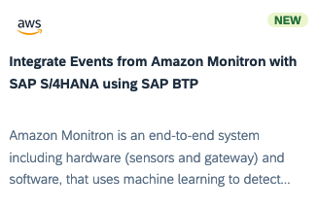
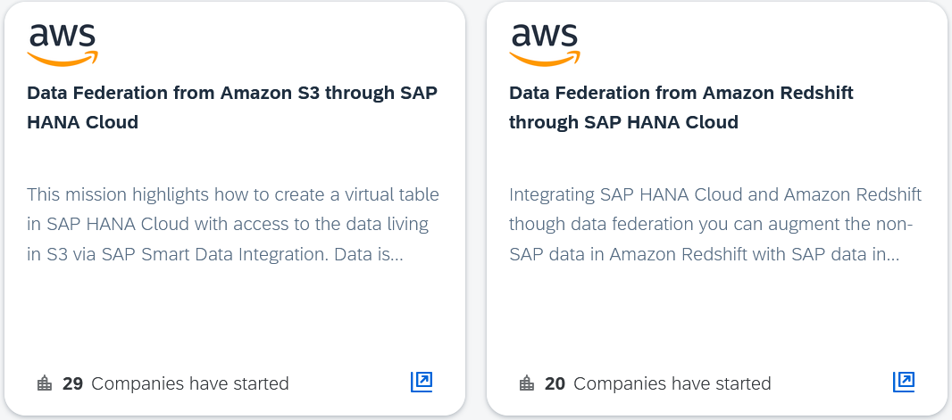


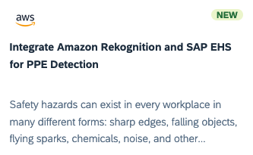
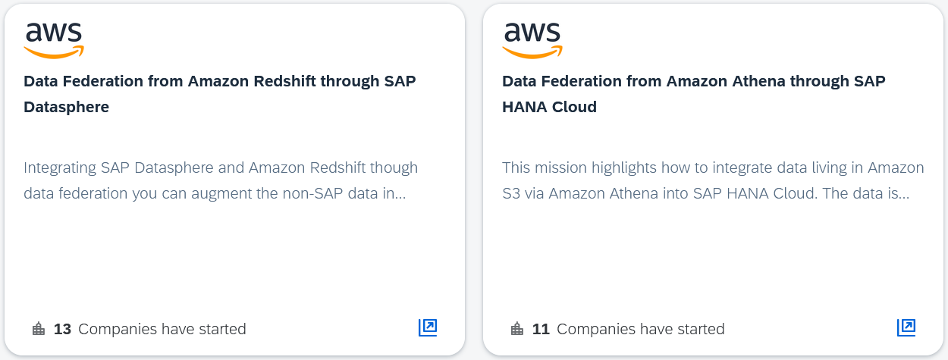
AWS Missions on SAP Discovery Center
Implement use cases on SAP Business Technology Platform with step-by-step guidance
Learn more
Notes:
Here are some of the use case driven missions – 1) Predictive maintenance 2) Computer vision based integration for quality and workplace safety 3) Data to value federation architecture 3) Secure connectivity and 4) Ful stack application development.

Slide 3
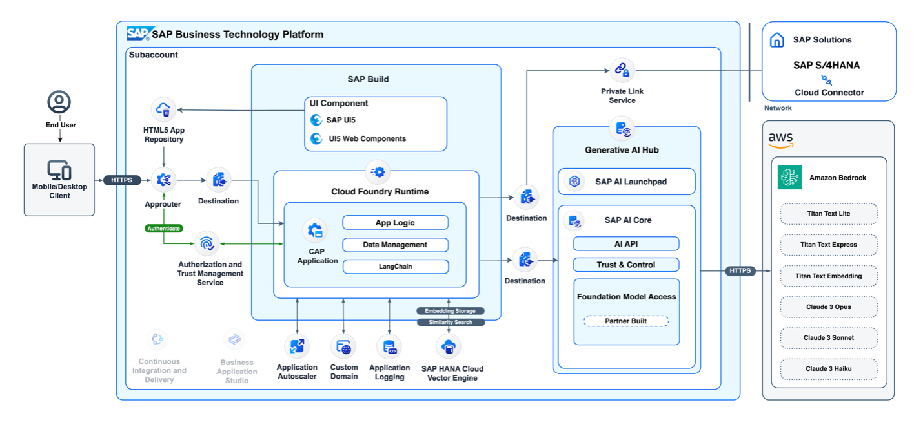

Secure and scalable access to generative AI
Notes:
SAP and AWS have provided a reference architecture to our customers for consuming generative AI capabilities of Amazon Bedrock with SAP BTP. Using this architecture, SAP workloads can now be supplemented with large language models (LLMs) and transformer model capabilities to harness the power of SAP data, resulting in improved insights and operational efficiencies at a lower cost.
From: https://aws.amazon.com/blogs/awsforsap/power-your-business-with-secure-and-scalable-generative-ai-services-from-aws-and-sap/

